Slide 1
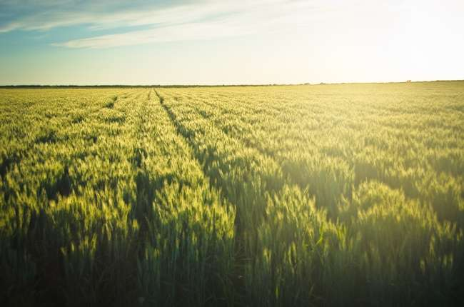
Automatic irrigation system
Yuvan Srivarshan D
Ajay Harriesh T
Ameer Khan M S
Team Members:

Slide 2
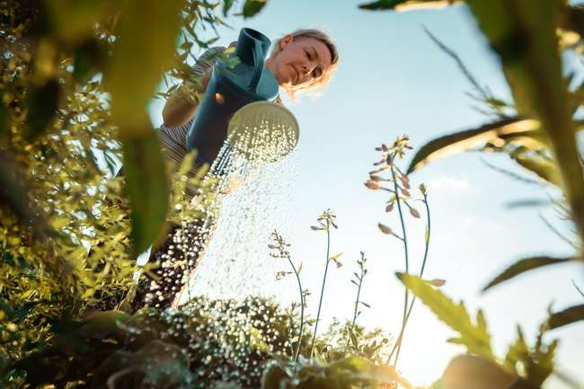
Actually this a automated irrigation system , which is used to sense the soils current state. And waters it how much it needs .By sensing the soils moisture ,temperature and humidity in air at a particular spot where the plant is.

Slide 3
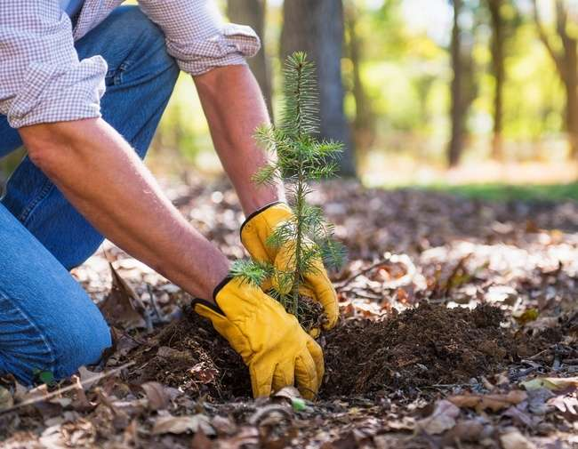
In our automatic irrigation system we have brought in many sensors in order to measure and continues monitoring of soil moisture level ,temperature at that spot and humidity in the air. So that we can avoid over watering for the plants.

Slide 4
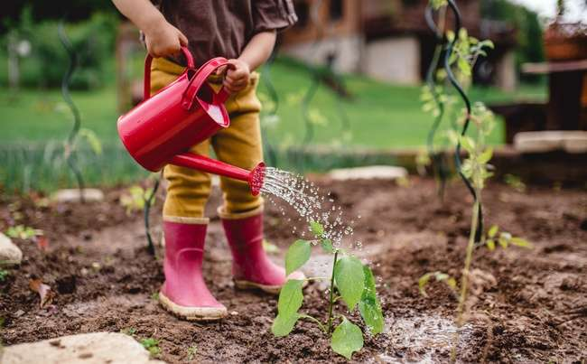
Globally a report says, more than 83% of crop failure is due to over watering plants.
Generally most of the plants has an ability to collect moisture from environmental air. So plants which is in a environment of good humid region and less temperature at that spot then the plant needs very less amount of water.

Slide 5
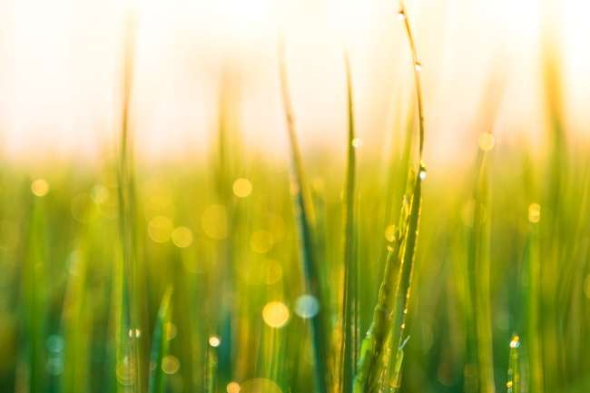
Here ,in this we bring IOT together using ThingSpeak. IOT is used for both monitoring and to make watering automated.
Using Thingspeak we can monitor soil moisture level from anywhere by just signing into ThingSpeak .And this ThinkSpeak has the record of last watering time and automatically initiates watering when the moisture level goes down below the preset values .

Slide 6

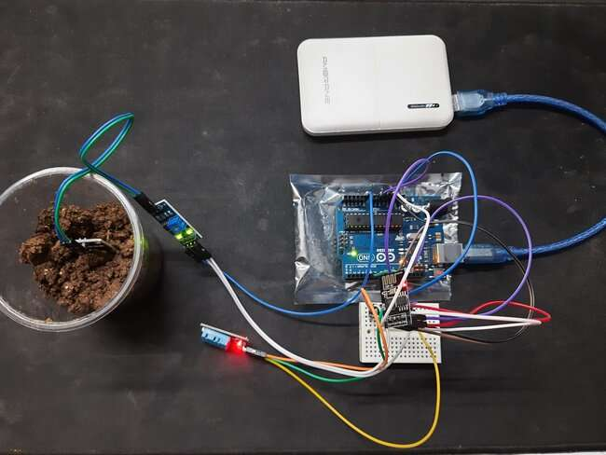
Final outcome:

Slide 7
Components used:
dht11
Soil moisture sensor
esp8266
Arduino board

Slide 8
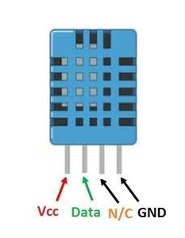
DHT11 sensor :
DHT11 is a Basic humidity & temperature Sensor Module , low-cost digital temperature and humidity sensor. It uses a capacitive humidity sensor and a thermistor to measure the surrounding air.
It does both the jobs of measuring temperature and humidity in air.
And it produces a digital output and so it should be connected to digital pins only.

Slide 9
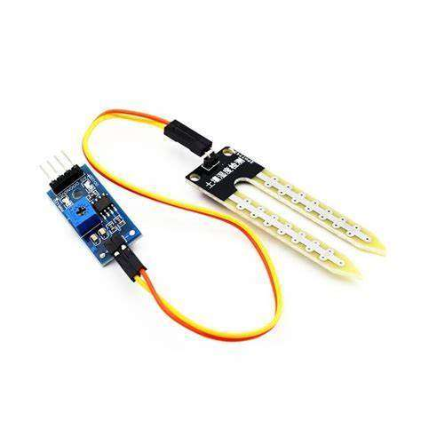
Soil moisture sensor:
Soil moisture sensor is used to measure the moisture level in the soil at that point.
When the threshold value is preset then, on getting measure below the preset value automatically our irrigation system starts to water plants.
So, this soil moisture sensor plays a main role in this system.

Slide 10
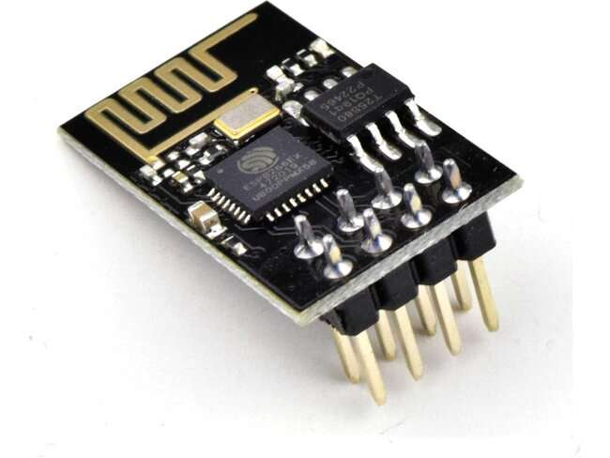
ESP8266 :
The ESP8266 is a low-cost Wi-Fi microchip, with built-in TCP/IP networking software, and microcontroller capability.
Actually this ESP8266 helps this whole irrigation system to connect with IOT and get report of measures together. And we use thingSpeak platform to view the output readings from any where.

Slide 11
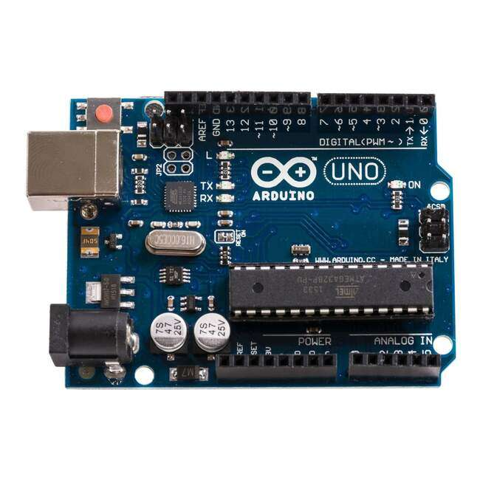
Arduino uno
Arduino Uno R3 is one kind of ATmega328P based microcontroller board. It includes the whole thing required to hold up the microcontroller; just attach it to a PC with the help of a USB cable.
Its has a programmable microcontroller on it,which works inaccordance to the code we give.

Slide 12
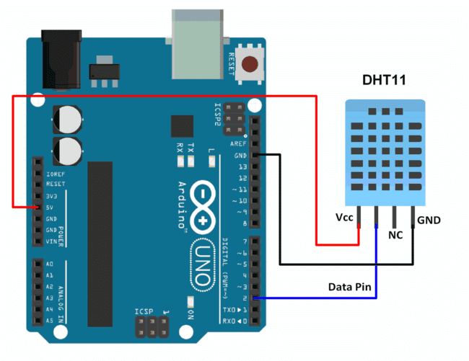
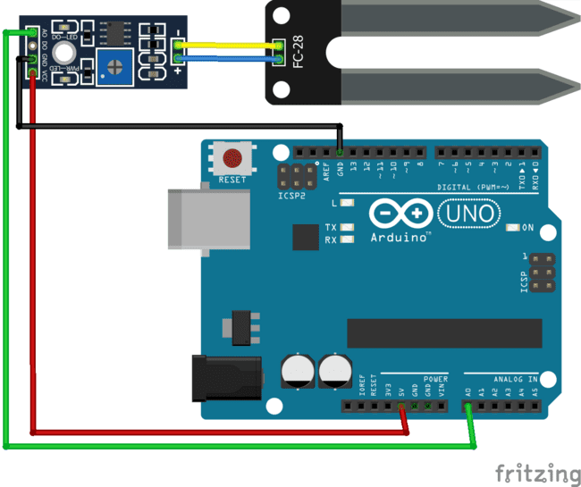
Connection diagram of DHT11 And Soil moisture sensor

Slide 13

Why IOT into irrigation?
IOT comes in when we get many data together ,we store it in internet.
We use IOT to have a record of previous measures, and compare it with the current one.
We access IOT through ThingSpeak to monitor the measure from any where at any time.
For other future upgrades and connecting with many systems IOT helps a lot.

Slide 14
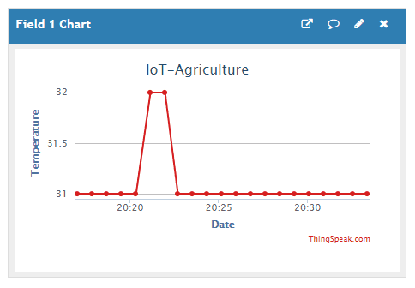
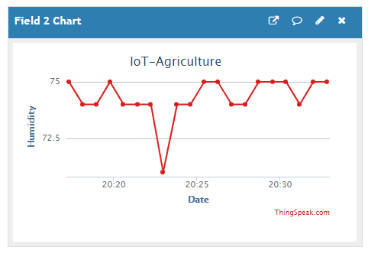
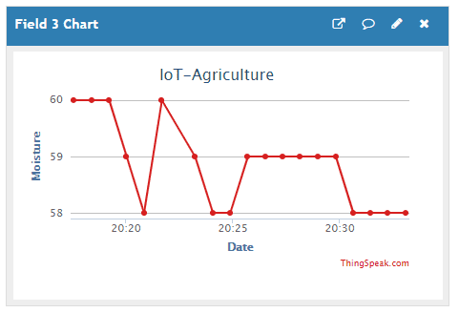
Sample Outputs:

Slide 15
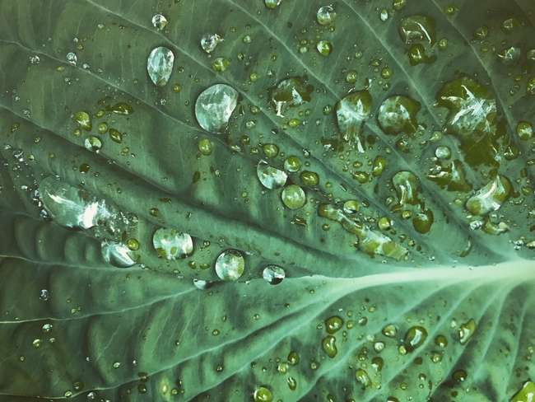
ADVANTAGES:
We can reduce water consumption for agriculture or small scale plantation.
We can reduce man power for regular watering of plants.
We can monitor water usage from anywhere.
Reduce crop failure due to over watering.

Slide 16
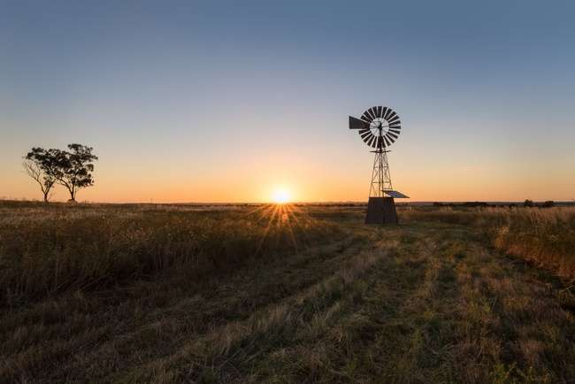
DISADVANTAGE:
It is costly for small scale plantation.
Takes over the work of daily wages .

Slide 17
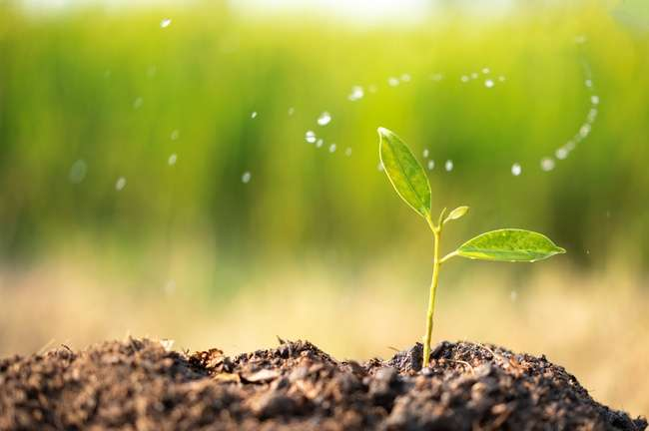
CONCLUSION:
To downscale the event of drought hit on our state, automatic irrigation system is proposed to ensure the moisture and humidity of soil in very simple and efficient design.

Slide 18
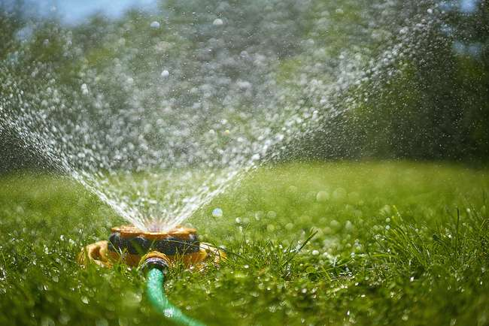
Thank You!!!

